Slide 1
HTML Basic Elements

Slide 2
HTML Text Formatting Elements
Syntax | Use
<b> | defines bold text, without any extra importance.
<strong> | defines strong text, with added semantic "strong" importance.
<i> | defines italic text, without any extra importance.
<em> | defines emphasized text, with added semantic importance.
<small> | defines small text.
<mark> | defines marked or highlighted text.
<del> | defines deleted (removed) of text.
<ins> | defines inserted (added) text.
<sub> | defines subscripted text.
<sup> | defines superscripted text.

Slide 3
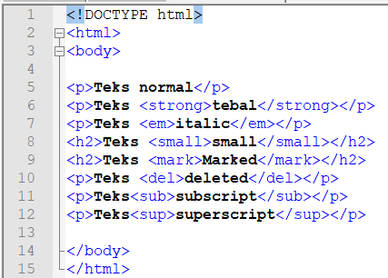
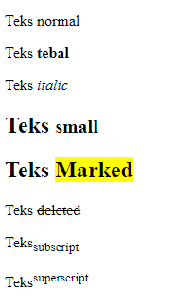
HTML Text Formatting Elements (cont.)

Slide 4
HTML Entities
Some characters are reserved in HTML.
If you use the less than (<) or greater than (>) signs in your text, the browser might mix them with tags.
Character entities are used to display reserved characters in HTML.
A character entity looks like this:
&entity_name; OR &#entity_number;
The advantage of using an entity name, instead of a number, is that the name is easier to remember. The disadvantage is that browsers may not support all entity names, but the support for numbers is good.

Slide 5
HTML Entities (2)
Result | Description | Entity Name | Entity Number
 | non-breaking space | &nbsp; | &#160;
< | less than | &lt; | &#60;
> | greater than | &gt; | &#62;
& | ampersand | &amp; | &#38;
¢ | cent | &cent; | &#162;
£ | pound | &pound; | &#163;
¥ | yen | &yen; | &#165;
€ | euro | &euro; | &#8364;
© | copyright | &copy; | &#169;
® | registered trademark | &reg; | &#174;

Slide 6
HTML Symbol Entities
Many mathematical, technical, and currency symbols, are not present on a normal keyboard.
To add these symbols to an HTML page, you can use an HTML entity name.
If no entity name exists, you can use an entity number; a decimal (or hexadecimal) reference.

Slide 7
Some Mathematical Symbols Supported by HTML
Char | Number | Entity | Description
∀ | &#8704; | &forall; | FOR ALL
∂ | &#8706; | &part; | PARTIAL DIFFERENTIAL
∃ | &#8707; | &exist; | THERE EXISTS
∅ | &#8709; | &empty; | EMPTY SETS
∇ | &#8711; | &nabla; | NABLA
∈ | &#8712; | &isin; | ELEMENT OF
∉ | &#8713; | &notin; | NOT AN ELEMENT OF
∋ | &#8715; | &ni; | CONTAINS AS MEMBER
∏ | &#8719; | &prod; | N-ARY PRODUCT
∑ | &#8721; | &sum; | N-ARY SUMMATION

Slide 8
Some Greek Letters Supported by HTML
Char | Number | Entity | Description
Α | &#913; | &Alpha; | GREEK CAPITAL LETTER ALPHA
Β | &#914; | &Beta; | GREEK CAPITAL LETTER BETA
Γ | &#915; | &Gamma; | GREEK CAPITAL LETTER GAMMA
Δ | &#916; | &Delta; | GREEK CAPITAL LETTER DELTA
Ε | &#917; | &Epsilon; | GREEK CAPITAL LETTER EPSILON
Ζ | &#918; | &Zeta; | GREEK CAPITAL LETTER ZETA

Slide 9
Some Other Entities Supported by HTML
Char | Number | Entity | Description
© | &#169; | &copy; | COPYRIGHT SIGN
® | &#174; | &reg; | REGISTERED SIGN
€ | &#8364; | &euro; | EURO SIGN
™ | &#8482; | &trade; | TRADEMARK
← | &#8592; | &larr; | LEFTWARDS ARROW
↑ | &#8593; | &uarr; | UPWARDS ARROW
→ | &#8594; | &rarr; | RIGHTWARDS ARROW
↓ | &#8595; | &darr; | DOWNWARDS ARROW
♠ | &#9824; | &spades; | BLACK SPADE SUIT
♣ | &#9827; | &clubs; | BLACK CLUB SUIT
♥ | &#9829; | &hearts; | BLACK HEART SUIT
♦ | &#9830; | &diams; | BLACK DIAMOND SUIT

Slide 10
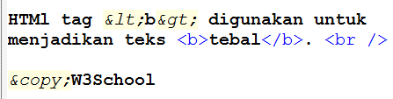




Slide 11
HTML Table
Tables are defined with the <table> tag.
Tables are divided into table rows with the <tr> tag.
Table rows are divided into table data with the <td> tag.
A table row can also be divided into table headings with the <th> tag.

Slide 12
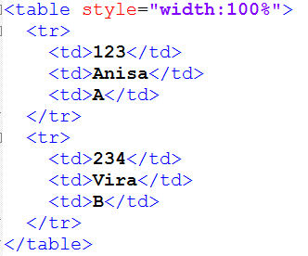

HTML Table Example

Slide 13
Border Attribute
If you do not specify a border for the table, it will be displayed without borders.
A border can be added using the border attribute:
<table border="1" style="width:100%">

Slide 14
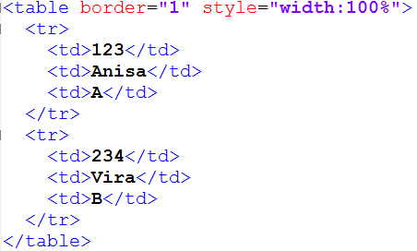


Slide 15
Table Headings
Table headings are defined with the <th> tag.
The text marked up as headers (th elements) is displayed differently from the other cells in the table (td elements) → but, it is not purely cosmetic.
Table headers are important because they provide information or context about the cells in the row or column they precede.
The th element may be handled differently than tds by alternative browsing devices.
Mark up the headers semantically and change the presentation later with a style rule.

Slide 16
Table Caption
To add a caption to a table, use the <caption> tag:
<caption>Data Mahasiswa</caption>

Slide 17
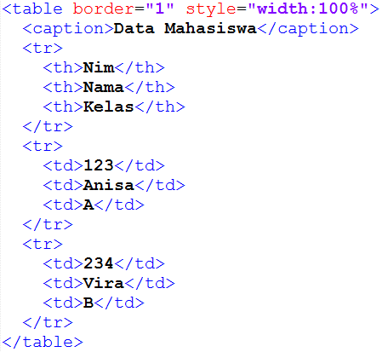
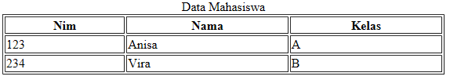

Slide 18
Table Cells that Span Many Columns/ Rows
To make a cell span more than one column, use the colspan attribute on <td> element.
To make a cell span more than one row, use the rowspan attribute on <td> element.

Slide 19
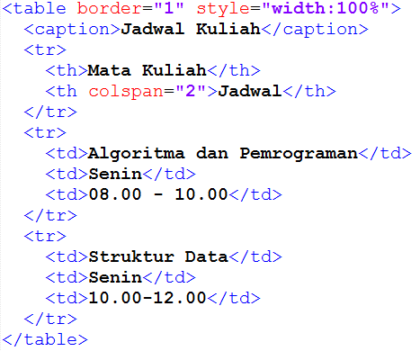
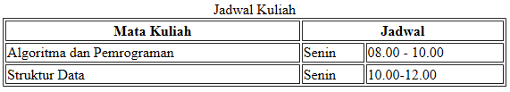

Slide 20
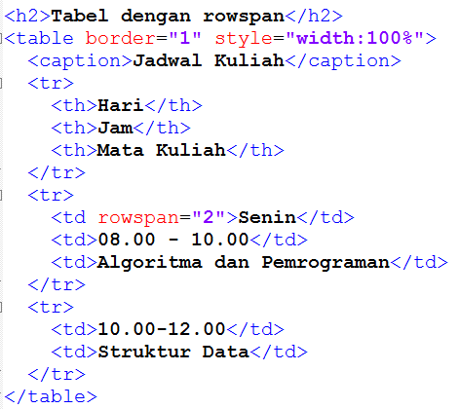
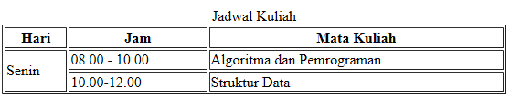

Slide 21
Table - Row Group Element
You can describe rows or groups of rows as belonging to a header, footer, or the body of a table using the thead, tfoot, and tbody elements, respectively.
Some user agents (another word for a browsing device) may repeat the header and footer rows on tables that span multiple pages.
Authors may also use these elements to apply styles to various regions of a table.

Slide 22
Table - Column group elements
Columns may be identified with the col element or put into groups using the colgroup element.
This is useful for adding semantic context to information in columns.
Notice that there is no content in the column elements; it just describes the columns before the actual table data begins.

Slide 23
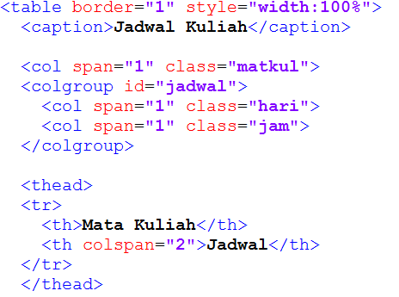
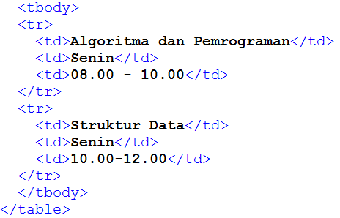

Slide 24
HTML Lists
Unordered HTML Lists
Ordered HTML Lists
HTML Description Lists
Nested HTML Lists

Slide 25
Unordered HTML Lists
Un unordered list starts with the <ul> tag. Each list item starts with the <li> tag.
The list items (by default) will be marked with bullets.
A style attribute can be added to an unordered list, to define the style of the marker:
Style | Description
list-style-type:disc | The list items will be marked with bullets (default)
list-style-type:circle | The list items will be marked with circles
list-style-type:square | The list items will be marked with squares
list-style-type:none | The list items will not be marked

Slide 26
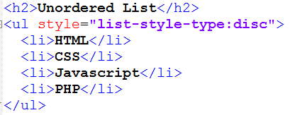
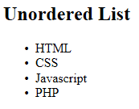
Unordered HTML Lists (cont.)

Slide 27
Ordered HTML Lists
An ordered list starts with the <ol> tag. Each list item starts with the <li> tag.
The list items will be marked with numbers (by default).
A type attribute can be added to an ordered list, to define the type of the marker:
Type | Description
type="1" | The list items will be numbered with numbers (default)
type="A" | The list items will be numbered with uppercase letters
type="a" | The list items will be numbered with lowercase letters
type="I" | The list items will be numbered with uppercase roman numbers
type="i" | The list items will be numbered with lowercase roman numbers

Slide 28
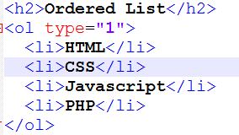
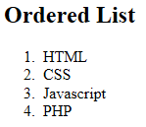
Ordered HTML Lists (cont.)

Slide 29
HTML Description Lists
A description list, is a list of terms, with a description of each term.
The <dl> tag defines a description list.
The <dt> tag defines the term (name), and the <dd> tag defines the data (description).

Slide 30
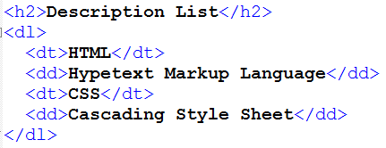
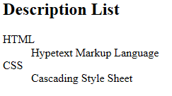
HTML Description Lists (cont.)

Slide 31
Nested HTML Lists
List can be nested (lists inside lists).
List items can contain new list, and other HTML elements, like images and links, etc.

Slide 32
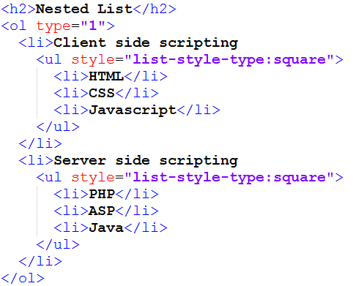
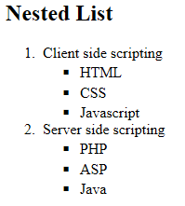

Slide 33
HTML Iframe
An iframe is used to display a web page within a web page.
Use the height and width attributes to specify the size of the iframe.
The attribute values are specified in pixels by default, but they can also be in percent (like "80%").

Slide 34
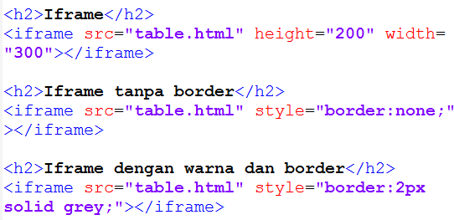
HTML Iframe (cont.)

Slide 35
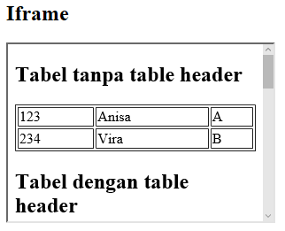
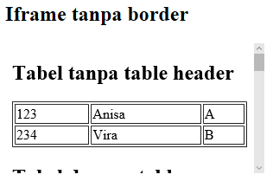
HTML Iframe (cont.)

Slide 36
HTML Iframe (cont.)
Iframe - Target for a Link
An iframe can be used as the target frame for a link.
The target attribute of the link must refer to the name attribute of the iframe.

Slide 37
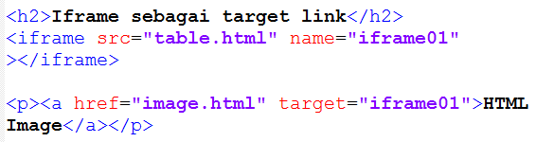
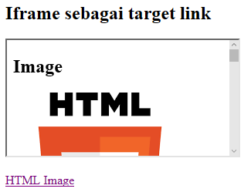
HTML Iframe (cont.)

Slide 38
HTML Block and Inline Elements
A block-level element always starts on a new line and takes up the full width available (stretches out to the left and right as far as it can).
Examples of block-level elements: <div>, <h1> - <h6>, <p>, <form>.
The <div> element is a block-level element.
The <div> element is often used as a container for other HTML elements.

Slide 39
HTML Block and Inline Elements
An inline element does not start on a new line and only takes up as much width as necessary.
Examples of inline elements: <span>, <a>, <img>
The <span> element is a inline element.
The <span> element is often used as a container for some text.

